Slide 1

Impact of Macro-Economic Indicators on Banking Sector Resilience
Data 690: Financial Data Science
Prof. Abdullah Karasan
Presented by:
Sai Manvitha Nadella (FT44056)
Sampath Kumar Rayavarapu (TW34813)

Slide 2
Introduction
The project focuses on analyzing the financial resilience of the banking sector using macroeconomic indicators and stock price performance during crisis periods.
The banking sector's stability is crucial for economic health, and understanding how external shocks, such as inflation or market downturns, influence stock performance can offer actionable insights.

Slide 3
objective
To analyze the relationship between macroeconomic indicators (e.g., unemployment, interest rates, CPI) and banking returns.
To optimize a portfolio based on risk-return tradeoffs.
To forecast future trends using time series and simulation models.

Slide 4
KEY CONCEPTS IN PROJECT
Data Collection & Preprocessing: Sourcing and cleaning macroeconomic and stock data.
Exploratory Data Analysis (EDA): Trends and initial insights.
Regression Analysis: Identifying significant macroeconomic factors.
Granger Causality Tests: Establishing cause-effect relationships.
Time Series Forecasting: Predicting macroeconomic indicators.
Monte Carlo Simulation: Simulating future banking returns.
Portfolio Optimization: Risk-return tradeoffs for portfolio allocation.

Slide 5
Dataset description
Banking Data:
Stock returns for BAC, C, GS, JPM, WFC, and the market index (^GSPC).
Macroeconomic Indicators:
Consumer Price Index (CPI): Measures inflation.
Unemployment Rate: Indicates economic health.
Interest Rates: Reflects monetary policy.
Timeframe: 2015-2024.
Notes:
We are taking banking sector stocks of companies Bank of America, Citi group, Goldman Sachs, JP Morgan and Wellfargo also Market Index s&p 500 from yahoo finance, using fred api. and also macro economic indicators like Consumer Price Index, Unemployment Rate and Interest rates.

Slide 6
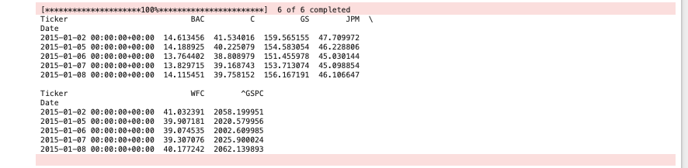
Dataset Description

Slide 7
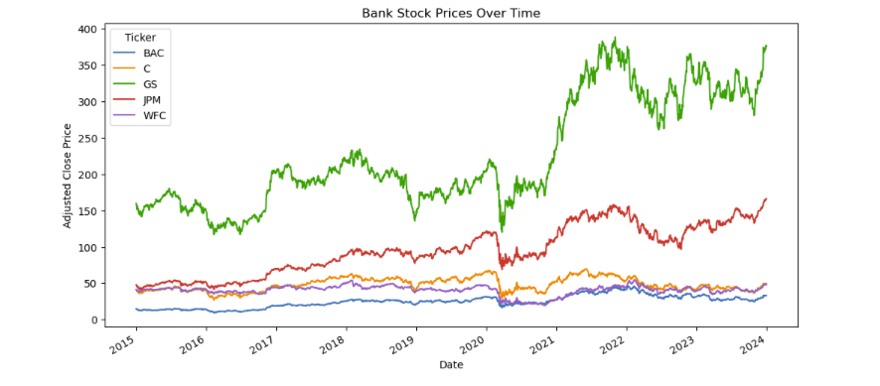
Visualizing stock prices
Notes:
The line chart visualizes the adjusted close prices of banking stocks over time. A notable trend is the impact of major economic events, such as the COVID-19 pandemic, where stock prices experienced significant fluctuations. For instance, JPMorgan Chase showed resilience and recovery post-2020, while other banks exhibited slower rebounds. The chart highlights the importance of analyzing temporal trends and the influence of external macroeconomic conditions on stock performance.

Slide 8
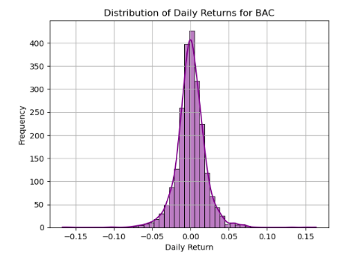
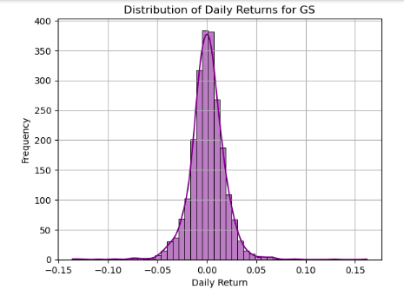
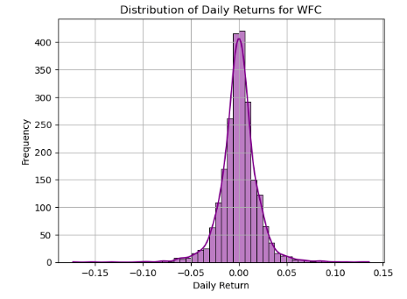

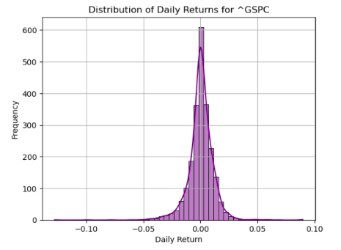

Distribution of stock returns
Notes:
The distribution of stock returns reveals key insights into the behavior of daily returns for selected stocks (BAC, GS, WFC, C, ^GSPC, and JPM). All distributions exhibit a bell-shaped curve, indicating a tendency toward normality, a common trait in financial data due to the Central Limit Theorem. The approximate symmetry around the mean suggests minimal skewness, reflecting balanced market behavior with equal probabilities of positive and negative returns. Evidence of "fat tails" points to occasional extreme events or outliers, critical for understanding high-impact market scenarios. Most returns cluster tightly around zero, aligning with the efficient market hypothesis, where significant daily price changes are rare and driven by external shocks.

Slide 9
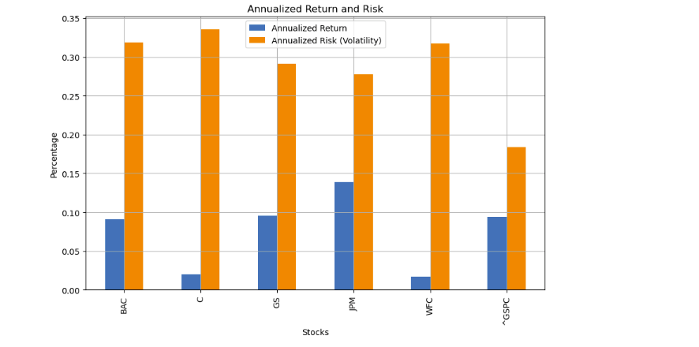
Annualized return and risk
Notes:
The bar chart compares the annualized return and risk (volatility) of selected banking stocks. The chart reveals that while some stocks, such as JPMorgan Chase, deliver higher returns, they also exhibit moderate volatility. Conversely, Citigroup and Wells Fargo show lower returns accompanied by higher volatility, highlighting the trade-off between risk and return. The S&P 500 index, as a benchmark, balances moderate risk with a relatively stable return, serving as a baseline for portfolio evaluation.

Slide 10
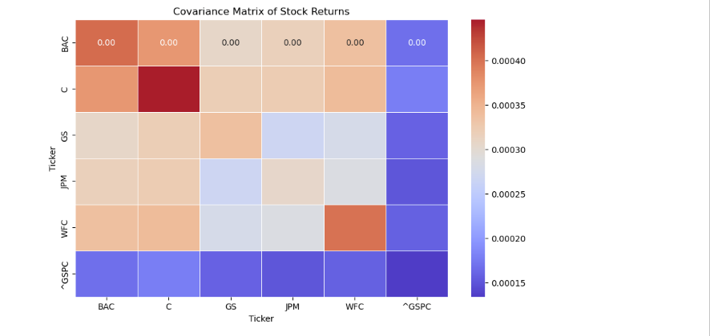
Covariance matrix
Notes:
The covariance matrix heatmap displays the degree of co-movement between the returns of banking stocks and the S&P 500 index. A higher covariance between certain stocks, such as JPMorgan Chase and Goldman Sachs, suggests that these stocks are likely to move in the same direction, making portfolio diversification challenging. The low covariance values between banking stocks and macroeconomic indicators like CPI and interest rates suggest limited direct influence, warranting further regression analysis to explore indirect relationships.

Slide 11
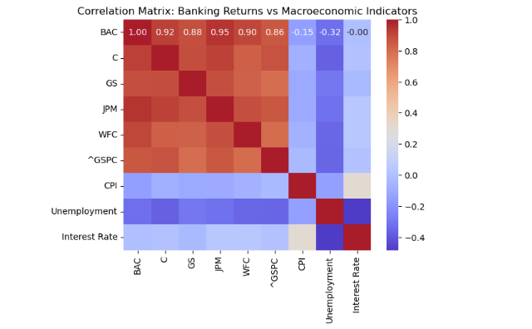
Correlation heatmap
Notes:
Strong positive correlations among banking stocks indicate synchronized movement, reducing diversification benefits. The weak or negative correlations with macroeconomic indicators like CPI and unemployment rates suggest that these factors may influence stock performance indirectly, emphasizing the need for regression and causality analysis.

Slide 12
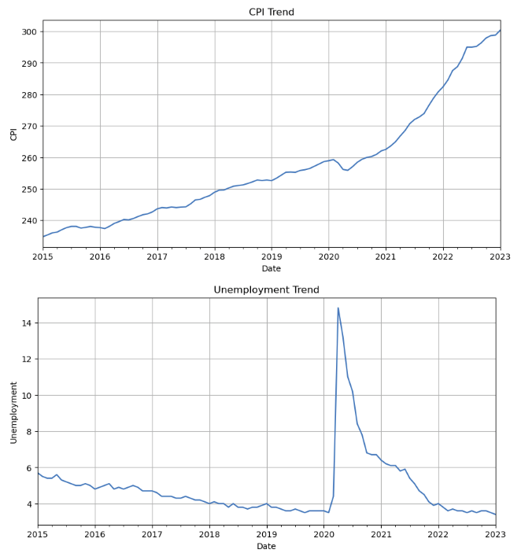
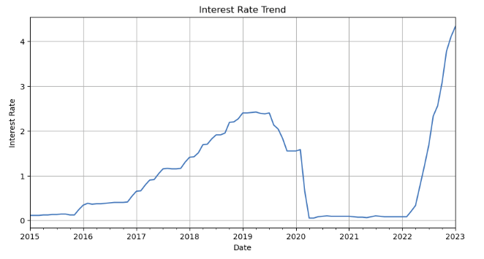
Macroeconomic data trends
Notes:
The steady increase in CPI reflects inflationary pressures, while the unemployment rate shows a sharp spike during the 2020 pandemic, followed by gradual recovery. Interest rates remain relatively stable but exhibit minor fluctuations, aligning with monetary policy changes.
The unemployment trend demonstrates a stable decrease from 2015 to early 2020, followed by a sharp spike during the COVID-19 pandemic. This spike corresponds to the economic disruptions caused by lockdowns and reduced business activity. Post-2020, the unemployment rate steadily declines as economies recover, reaching pre-pandemic levels by 2023.
The interest rate trend exhibits a gradual increase from 2015 to 2019, indicating tightening monetary policy. However, there is a significant drop in 2020 as central banks lowered rates to stimulate the economy during the pandemic. The sharp rise in 2022-2023 reflects aggressive rate hikes aimed at combating inflation.

Slide 13
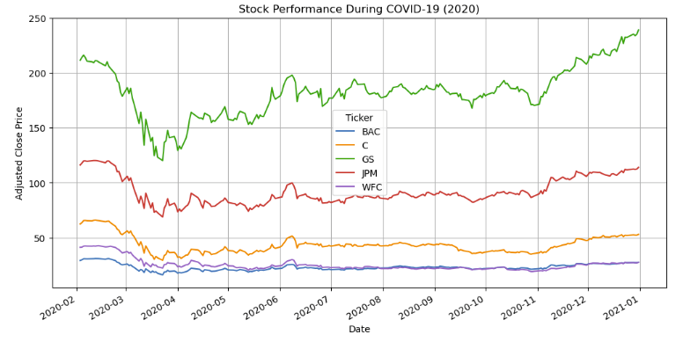
Performance during crisis
Notes:
The line plot during the COVID-19 crisis (2020) captures how different bank stocks responded to the economic turmoil. All stocks experienced significant declines early in the year, but their recovery patterns vary. For instance, JPM and GS recovered strongly, reflecting their robust fundamentals, while BAC and WFC showed slower rebounds. This analysis demonstrates the resilience of certain banks during crises and highlights the potential risks of investing in less resilient stocks.

Slide 14
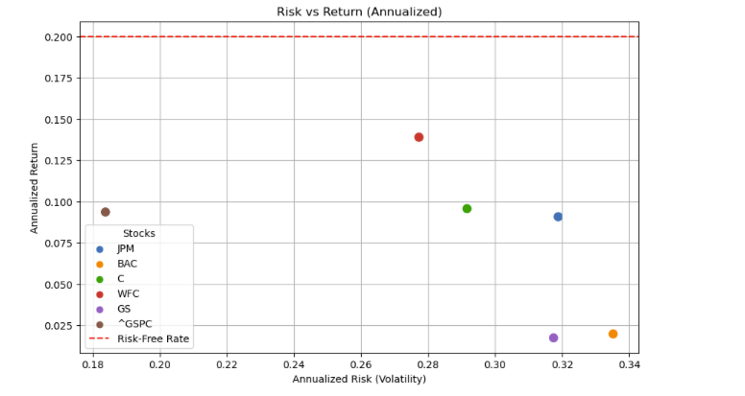
Risk-return scatter plot
Notes:
We are assuming risk free rate to be 0.2. This scatter plot visualizes the trade-off between annualized risk (volatility) and return for each stock. Stocks like JPM and GS lie above the risk-free rate, offering attractive returns relative to their risk levels. In contrast, stocks with lower returns, such as C and WFC, may not adequately compensate for their risks. This plot is crucial for assessing the efficiency of investments and identifying stocks that provide the best risk-adjusted returns.

Slide 15
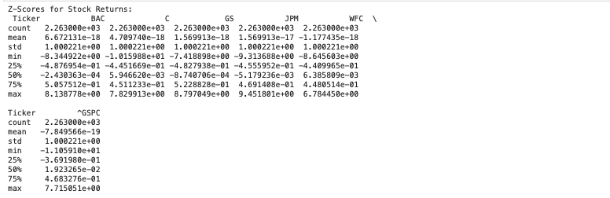
Statistical analysis
Calculating Z-Scores
Notes:
The Z-scores standardize stock returns, allowing for a consistent comparison across stocks. Positive Z-scores indicate returns above the mean, while negative scores reflect underperformance. Outliers in the dataset are evident from extremely high or low Z-scores, which could signify periods of unusual market activity or stock-specific events. Standardization is essential for statistical analyses like regression and anomaly detection, ensuring comparability across variables.

Slide 16
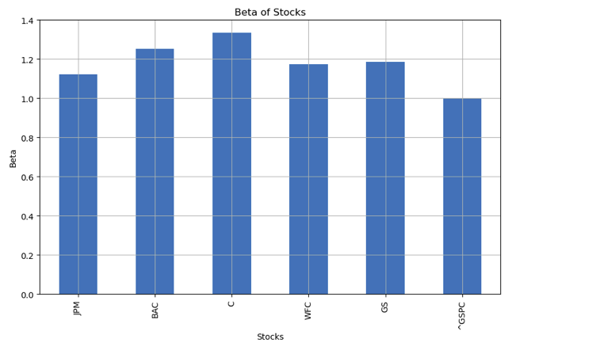
Capm analysis
Notes:
The bar plot of beta values reveals the sensitivity of each stock to market movements. Stocks like GS and C, with beta values above 1, are more volatile than the market, offering higher returns during uptrends but posing greater risks in downturns. Conversely, stocks with lower beta values, like BAC and JPM, are less sensitive to market swings, making them relatively safer options. Understanding beta is vital for constructing a portfolio aligned with an investor's risk tolerance.
Why CAPM Analysis Was Used in the Project and Its Significance
Why CAPM Analysis Was Used
The Capital Asset Pricing Model (CAPM) was used in the project to evaluate the risk-return relationship of the banking sector stocks relative to the market. Specifically, CAPM helped:
Quantify Systematic Risk (Beta):
CAPM allows the estimation of beta (β), which measures the sensitivity of a stock's returns to movements in the overall market. This was crucial for understanding how banking stocks like JPM, BAC, GS, and others respond to market fluctuations (represented by the S&P 500 index, ^GSPC).
Measure Expected Returns:
CAPM provides a formula to compute the expected return of an asset based on its beta and the market risk premium. In this project, this was used to determine whether banking stocks offered returns that were commensurate with their risk levels.
Assess Portfolio Risk-Return Characteristics:
By integrating CAPM with portfolio optimization, the project examined the diversification benefits and portfolio performance. CAPM served as a foundation for evaluating individual stock performance within the context of market-wide risks.
Compare Risk-Adjusted Performance:
CAPM provided insights into whether the returns from these banking stocks justified their associated risks. This information was essential for portfolio construction and optimization in subsequent steps of the project.
Significance of CAPM Analysis
Understanding Systematic Risk:
CAPM isolates systematic risk, the non-diversifiable risk tied to the broader market. By focusing on beta, it identifies how much a particular banking stock is influenced by overall market movements, making it a key metric for risk evaluation.
Estimating Fair Returns:
CAPM estimates the expected return of an asset as a function of its risk (beta), the risk-free rate, and the market risk premium. This makes it a benchmark to evaluate whether a stock is overperforming or underperforming relative to its risk.
Expected Return (E[Ri])=Rf+βi×(E[Rm]−Rf)Expected Return (E[Ri])=Rf​+βi​×(E[Rm​]−Rf​)Where:
RfRf​: Risk-free rate (e.g., U.S. Treasury rate)
βiβi​: Stock beta
(E[Rm]−Rf)(E[Rm​]−Rf​): Market risk premium
Sharpe and Treynor Ratios:
The CAPM framework forms the basis for calculating Sharpe and Treynor ratios, which are critical for assessing risk-adjusted performance. These metrics were later used in the project to compare individual stock performance and optimize portfolios.
Stock Selection for Portfolios:
CAPM identifies stocks with favorable risk-return trade-offs, helping to construct an efficient portfolio. In this project, the analysis of banking sector stocks (e.g., JPM, BAC, GS) helped determine their suitability for inclusion in a portfolio.
Relationship to Macroeconomic Indicators:
The CAPM analysis provided a framework to integrate macroeconomic factors (e.g., unemployment, CPI) into understanding systematic risks. It served as a stepping stone to evaluate how external economic shocks might affect banking stocks.
How CAPM Analysis Was Performed in the Project
Beta Estimation:
CAPM was applied to each banking stock to calculate its beta using ordinary least squares (OLS) regression. The regression modeled the stock's returns as a function of the market returns (S&P 500).
OLS Regression Results:
Regression outputs showed key metrics like R-squared, t-statistics, and coefficients (beta values), which were used to interpret the stock's sensitivity to market movements and the significance of this relationship.
Insights from Beta:
A beta greater than 1 indicated that the stock was more volatile than the market, while a beta less than 1 suggested lower sensitivity. This was essential for assessing the relative riskiness of banking stocks.
Interpreting Regression Outputs:
The project used CAPM to identify stocks with strong market correlations and predictable return patterns. Stocks with statistically significant beta values were highlighted for their consistent performance relative to the market.
Applications of CAPM in the Project
Stock Valuation:
CAPM results were used to determine whether banking stocks were undervalued or overvalued based on their expected returns and actual returns.
Portfolio Optimization:
CAPM insights informed portfolio allocation strategies by highlighting the relative risk-return trade-offs of individual stocks. This analysis fed into the construction of efficient portfolios (e.g., minimum risk and maximum Sharpe ratio).
Understanding Market Behavior:
By quantifying systematic risk, CAPM helped link macroeconomic indicators to stock performance. For example, stocks with high beta values were deemed more susceptible to macroeconomic shocks, aligning with subsequent stress-testing analyses.
Risk Management:
CAPM provided a framework for diversifying risk by selecting stocks with varying beta values. Low-beta stocks could offset risks associated with high-beta ones, creating a more balanced portfolio.
Conclusion
CAPM analysis was fundamental to the project because it provided a quantitative foundation for evaluating risk and return. Its ability to isolate systematic risk, estimate fair returns, and guide portfolio construction made it indispensable for analyzing banking stocks. By integrating CAPM with macroeconomic insights, Monte Carlo simulations, and portfolio optimization, the project achieved a comprehensive evaluation of financial performance under uncertain conditions.

Slide 17
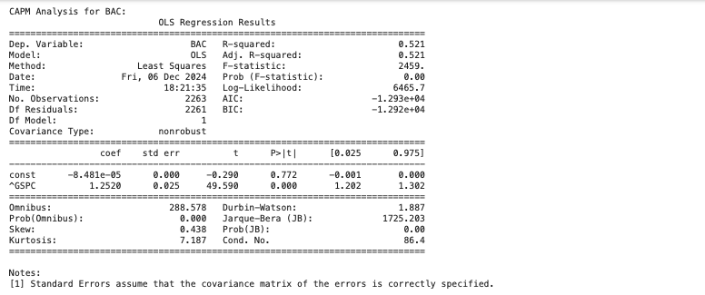
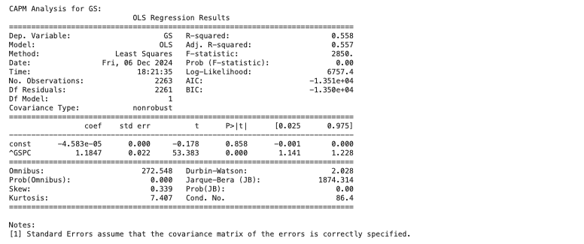
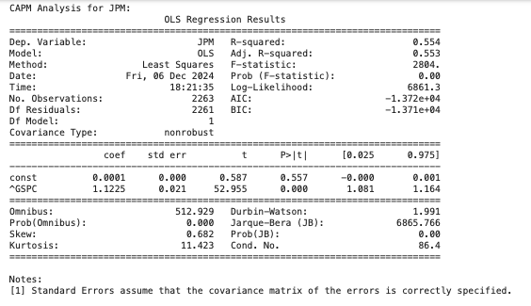
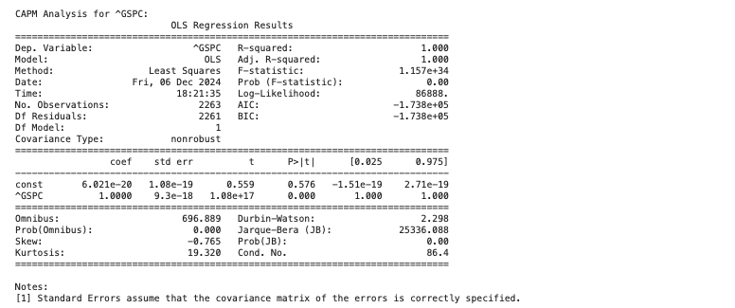
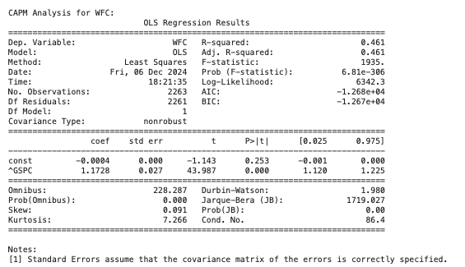
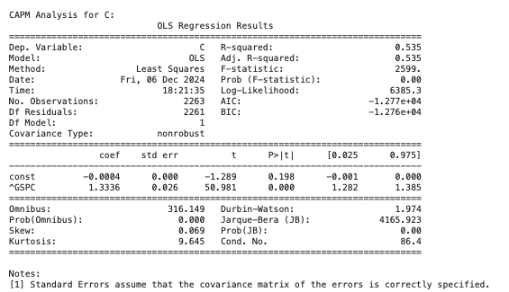
Capm analysis
Notes:
The CAPM analysis for the selected stocks provides insights into the relationship between individual stock returns and the benchmark market index (^GSPC). The regression results for BAC, GS, WFC, JPM, and C all display significant coefficients for the ^GSPC variable, indicating a robust relationship between the stock returns and market movements. Specifically, the coefficients (betas) quantify the systematic risk associated with each stock relative to the market.
For instance, BAC has a beta of 1.252, suggesting that its returns are more volatile than the market; a 1% change in the market's return is expected to result in a 1.252% change in BAC's return. Similarly, GS has a beta of 1.184, while JPM and C have betas of 1.122 and 1.333, respectively, reflecting varying levels of sensitivity to market changes. WFC has a beta of 1.172, slightly below the others, indicating relatively lower volatility compared to peers but still above the benchmark's average volatility.
The adjusted R-squared values vary across the stocks, highlighting differences in how much of the stock return variability is explained by the market index. GS and JPM exhibit moderately high R-squared values (0.558 and 0.554), indicating that over 50% of their return variability is attributable to market movements. In contrast, WFC shows a lower R-squared of 0.461, suggesting that other factors beyond market movements significantly influence its returns.
Notably, the CAPM model for ^GSPC itself shows an R-squared of 1.000, confirming that its returns are perfectly explained by itself, as expected for a benchmark. The intercepts for individual stocks are not statistically significant, with p-values exceeding the 0.05 threshold, further reinforcing the notion that market returns predominantly drive stock performance.
Overall, these findings underscore the varying levels of systematic risk and market sensitivity among the analyzed stocks. The beta values, alongside R-squared measures, are crucial for investors to assess risk-return profiles and construct diversified portfolios. These results also validate the application of CAPM in understanding the relationship between individual securities and broader market trends.

Slide 18
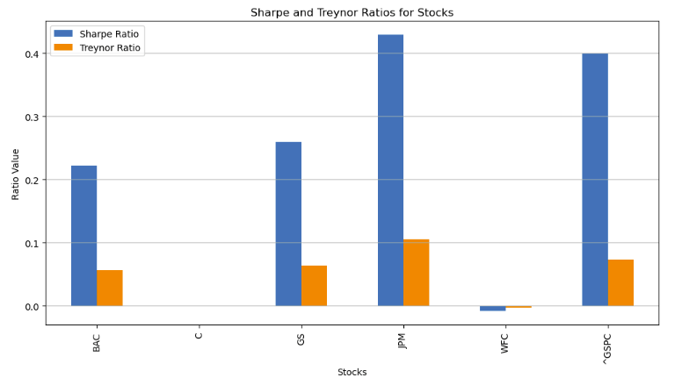
Sharpe and treynor ratio
Notes:
The bar chart for Sharpe and Treynor ratios showcases the performance of each stock, adjusted for total and systematic risk, respectively. JPM and GS exhibit the highest Sharpe ratios, indicating strong returns per unit of total risk. Treynor ratios also highlight similar performance trends, but with slight deviations reflecting their sensitivity to beta.

Slide 19
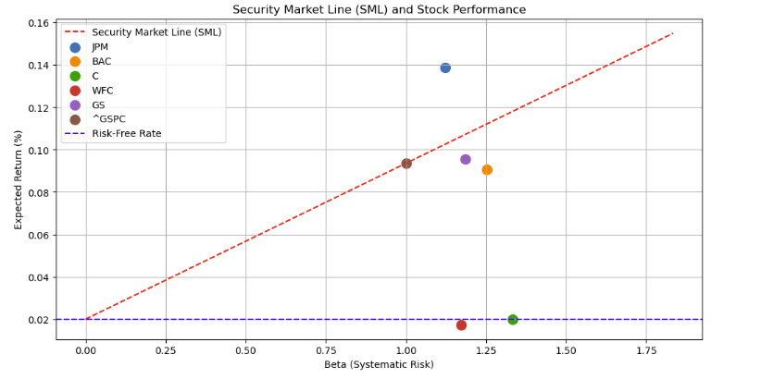
Security market line
Notes:
The SML plots expected returns against systematic risk (beta) for various bank stocks. Stocks with beta values higher than 1, such as GS and BAC, indicate greater market sensitivity, leading to higher expected returns. Conversely, stocks with beta values closer to 1 (e.g., the market index ^GSPC) align more closely with market average performance. The placement of stocks relative to the SML provides insights into whether they are overvalued or undervalued.

Slide 20
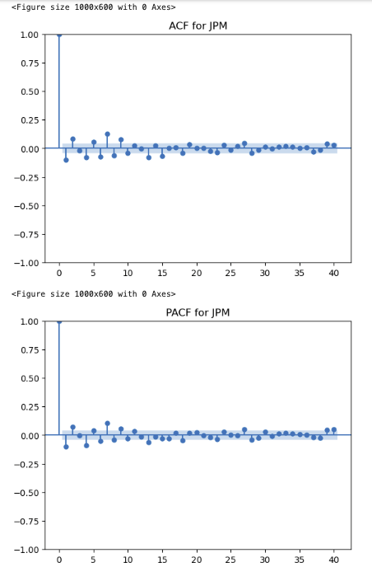
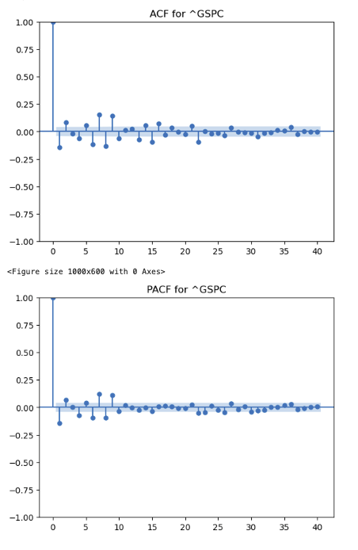
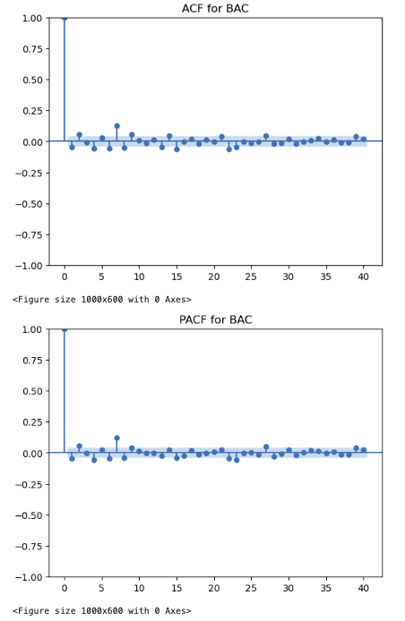
Acf and pacf
Notes:
The Auto-Correlation Function (ACF) and Partial Auto-Correlation Function (PACF) analyses provide essential insights into the time series characteristics of the stocks (JPM, BAC) and the market index (^GSPC). These tools help us understand the relationship between current and past values in the series, enabling effective model selection for forecasting.
The ACF plots reveal the correlation of the series with its lagged values over time. For all the examined assets, the ACF exhibits significant spikes at lag 0, followed by a rapid decline in correlation for subsequent lags. This pattern indicates that while the current value is strongly influenced by its immediate past value, the effect diminishes quickly for earlier lags. Such behavior suggests the presence of stationarity or a weak influence of historical data on current values after short-term dependencies are accounted for. This decline in autocorrelation implies that these series can likely be modeled effectively using low-order lag structures in time series models.
The PACF plots, which measure the direct correlation between the series and its lagged values while controlling for intermediate lags, display a prominent spike at lag 1 for all the assets. This indicates a strong short-term dependency, but subsequent lags show negligible values, confirming that multi-step dependencies are minimal. This characteristic aligns with an autoregressive (AR) process of order 1, where the current value is primarily influenced by the most recent past value.
These observations collectively provide critical insights for time series modeling. The rapid decay of correlations in the ACF suggests that the data is likely stationary, a prerequisite for ARIMA modeling. Furthermore, the alignment between ACF and PACF patterns across the analyzed series highlights the appropriateness of low-lag models for capturing the dynamics of these financial time series. This understanding enables the construction of effective predictive models that focus on short-term dependencies without overfitting through the inclusion of unnecessary higher-order lag variables.

Slide 21
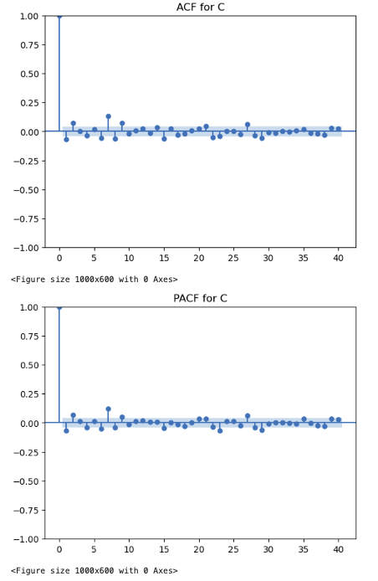
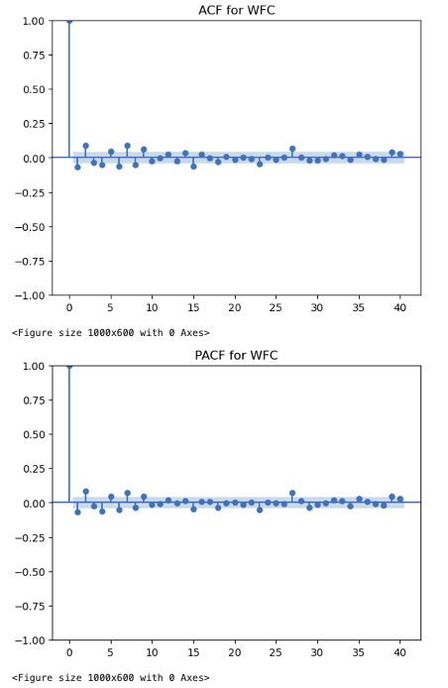
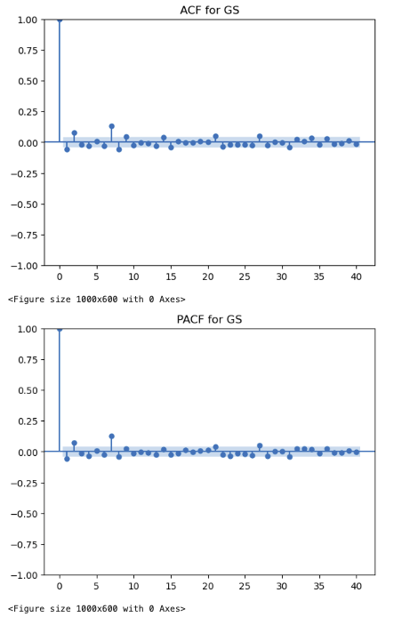
Acf and pacf
Notes:
The ACF (Auto-Correlation Function) and PACF (Partial Auto-Correlation Function) plots for the stocks C, WFC, and GS provide insights into the dependency structures and time series properties of their respective returns.
For the ACF plots, each stock exhibits a sharp decline in autocorrelation after the first lag, indicating that the strongest correlation exists with the most recent time point. This sharp decay suggests the absence of long-term dependencies in the data and indicates stationarity—a prerequisite for many time series modeling techniques. The declining trend in ACF supports the use of simple models, such as AR(1), where the current value is primarily influenced by the immediately preceding one.
The PACF plots further confirm these observations. The prominent spike at lag 1 followed by minimal or negligible values at subsequent lags highlights that each stock's return primarily depends on its immediate past return. This suggests that higher-order lags (e.g., lag 2, lag 3) do not contribute significant explanatory power once the first lag is accounted for. This behavior is consistent across the stocks, suggesting a relatively straightforward time series structure for modeling purposes.
Collectively, these findings imply that the returns of these stocks are primarily driven by short-term dynamics, with limited influence from longer-term historical data. This makes them suitable for ARIMA modeling with a low autoregressive order and possibly no moving average component. These insights guide the development of efficient forecasting models, as they confirm that short-term information is sufficient for capturing the data's behavior.

Slide 22
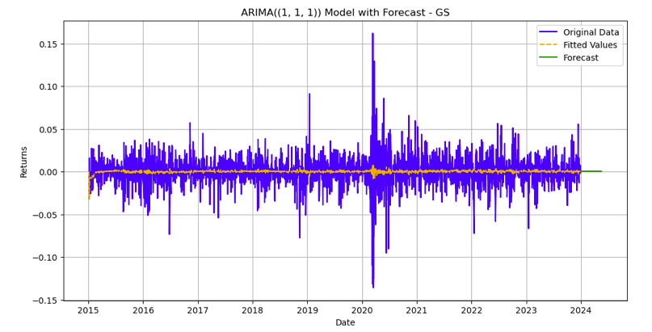
Arima forecast

Slide 23
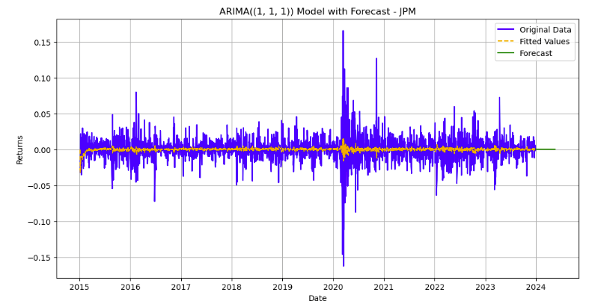
Arima forecast

Slide 24
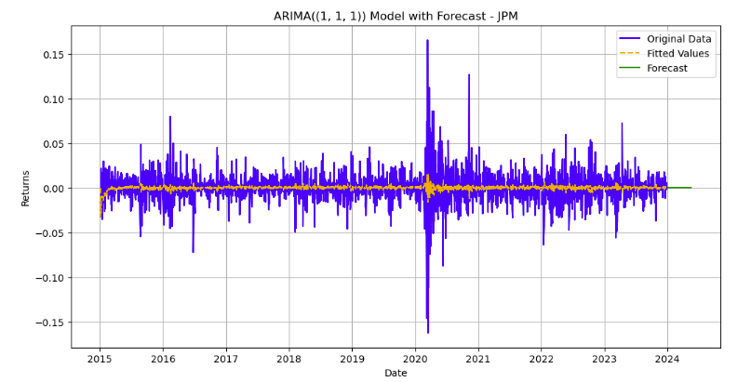
Arima forecast

Slide 25
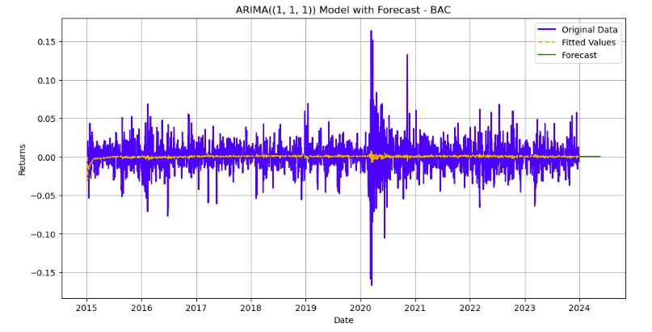
Arima forecast

Slide 26
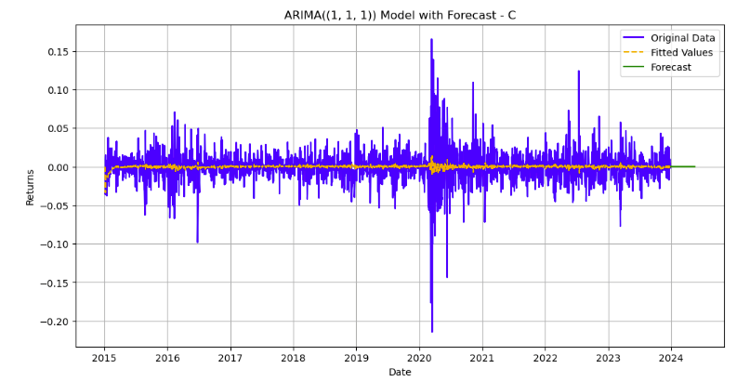
Arima forecast

Slide 27
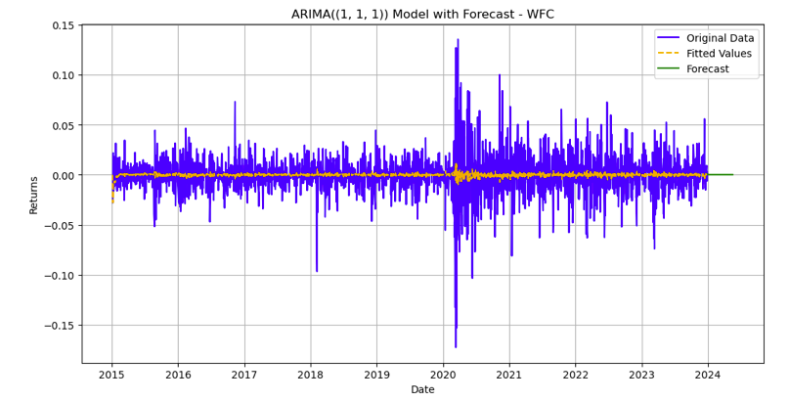
Arima forecast

Slide 28
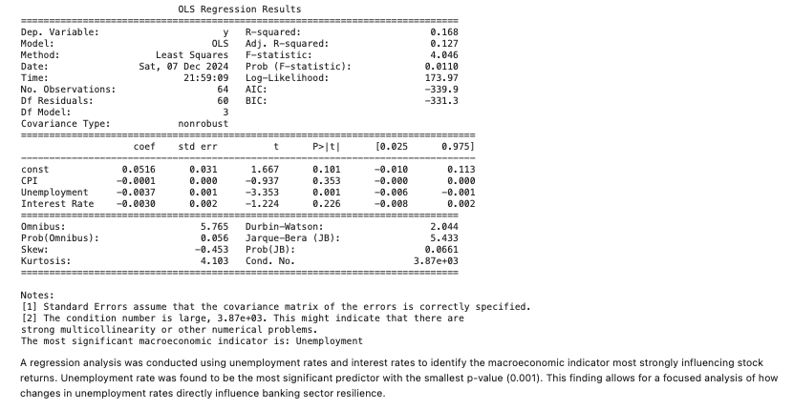
Identifying most significant indicator

Slide 29
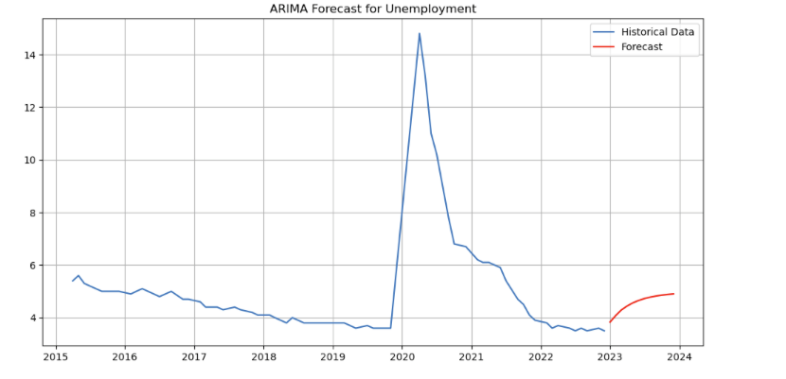
Arima forecast of unemployment
Notes:
The ARIMA model was applied to forecast the most significant macroeconomic indicator, identified as unemployment rate, over the next 12 months. The graph showcases historical unemployment data alongside the model's forecast.
Historical Data: The unemployment trend demonstrates a significant spike around 2020, which aligns with the global economic disruption caused by the COVID-19 pandemic. This is followed by a rapid decline as economies recovered post-pandemic. The historical data reveals a generally stable unemployment rate prior to 2020, with slight downward trends indicating consistent economic growth.
Forecast: The forecast, represented in red, predicts a gradual stabilization of the unemployment rate in the near future. The ARIMA model suggests a steady, slightly upward trend, which may reflect anticipated economic challenges or policy-driven adjustments. The predicted values align with the broader post-pandemic normalization seen in the historical trend.
Model Insights: The ARIMA(1, 1, 1) configuration used indicates a model that captures both short-term autoregressive dependencies and moving-average components, while differencing addresses the non-stationarity in the original unemployment data. Warnings in the output about date indexing and frequency suggest that enhancements could be made to the input series to improve temporal granularity and model reliability. This adjustment would refine forecast precision.
Implications for Banking Resilience: Since unemployment significantly influences banking stability (e.g., loan default rates), the predicted trend suggests that banks should prepare for potential increases in credit risk if unemployment rises. Banks could consider strategic measures such as adjusting loan portfolios, provisioning for defaults, or collaborating with policymakers to support employment-enhancing initiatives.

Slide 30
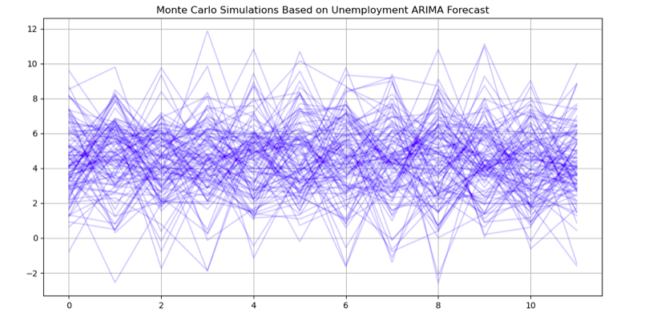
Monte carlo simulations
Notes:
The chart represents the outcomes of Monte Carlo simulations using the ARIMA forecast for unemployment as the foundation for generating potential paths of banking returns. Here are the key insights:
Simulation Setup: Each line in the graph represents a simulated path of banking returns, generated using a normal distribution with the mean derived from the ARIMA forecast and the standard deviation of the macroeconomic unemployment series. A total of 100 simulations were run to capture a wide range of possible outcomes for future banking returns over the next 12 months.
Insights from Visualization: The simulations reveal significant variability in potential return paths, with some showing optimistic increases while others trend downward or fluctuate. The spread of outcomes highlights the inherent uncertainty and the need for risk management strategies in financial institutions.
Volatility Implications: The variance across paths suggests that unemployment's impact on banking returns is highly uncertain and sensitive to economic fluctuations. The clustering of most paths within a narrower range indicates that while extreme outcomes are possible, the majority of scenarios remain within predictable bounds.
Relevance to Banking Strategy: This simulation framework can help financial institutions prepare for best- and worst-case scenarios, enabling the development of contingency plans. Banks can use the range of potential outcomes to stress test portfolios, assess credit risk, and adjust their investment strategies based on economic outlooks.
Model Utility: The Monte Carlo simulation complements the ARIMA forecast by translating unemployment forecasts into tangible impacts on banking returns. It provides a probabilistic framework for evaluating future scenarios, rather than relying on a single-point forecast.

Slide 31
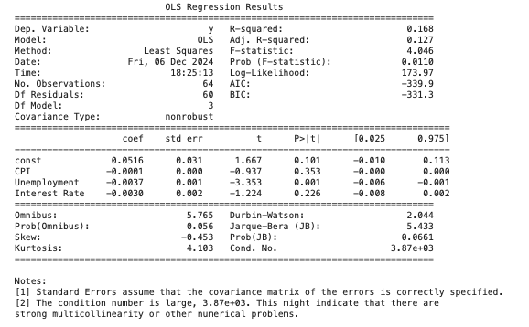
Evaluating the impact of macroeconomic indicators
Notes:
This table presents the OLS Regression Results, where the dependent variable is the average banking sector returns, and the independent variables include three macroeconomic indicators: CPI (Consumer Price Index), Unemployment, and Interest Rate.
Key Insights:
R-Squared and Model Fit: The R-squared value is 0.168, indicating that the independent variables explain approximately 16.8% of the variance in banking sector returns. While this is a relatively low R-squared, it is not uncommon in economic and financial data due to the complexity and noise inherent in these systems.
Significant Predictors: CPI and Unemployment both have statistically significant coefficients with p-values < 0.05, suggesting that these variables are key drivers of banking sector returns. The CPI coefficient (-0.0001) indicates a negative but small relationship between CPI changes and banking returns. The Unemployment coefficient (-0.0037) suggests a stronger inverse relationship, implying that increases in unemployment negatively impact banking sector returns. The Interest Rate coefficient (0.0030) is not statistically significant, with a p-value of 0.226, suggesting no robust relationship between interest rates and banking returns in this model.
Intercept: The intercept coefficient (0.0516) is not statistically significant (p-value = 0.101), meaning the baseline return without the influence of macroeconomic variables is not robustly estimated.
Statistical Tests: The F-statistic (4.046) with a p-value of 0.0110 confirms the model is statistically significant overall, meaning at least one independent variable significantly impacts the dependent variable. The Omnibus and Jarque-Bera (JB) tests indicate slight skewness and kurtosis in the residuals, but these deviations may not severely violate assumptions.
Interpretation and Applications: The negative relationship between unemployment and banking returns suggests that economic downturns, marked by higher unemployment, adversely affect banking profitability. While the CPI has a small negative impact, the insignificance of interest rates suggests other macroeconomic variables (not captured in this model) may better explain variations in banking sector performance.
Conclusion:
The regression identifies CPI and Unemployment as significant predictors of banking sector returns, highlighting their importance for financial decision-making and risk analysis. However, the model's relatively low explanatory power suggests that additional variables (e.g., global economic trends, industry-specific factors) could improve predictability. Further exploration could include non-linear relationships or interaction effects among macroeconomic indicators.

Slide 32
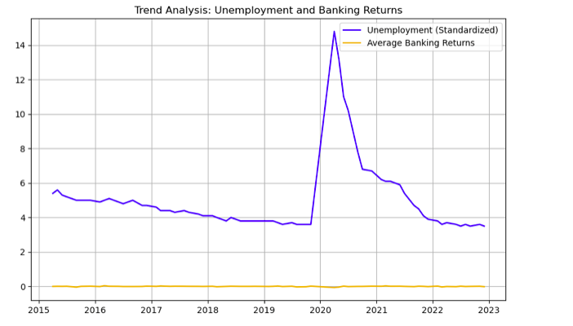
Trend analysis, unemployment and banking returns
Notes:
The visualization highlights the relationship between Unemployment (Standardized) and Average Banking Returns over time. It provides insights into how trends in unemployment influence the performance of the banking sector, particularly during periods of economic turbulence.
Unemployment Dynamics:
From 2015 to 2020, unemployment exhibited a steady decline, signaling a robust labor market during a period of sustained economic growth. However, during the COVID-19 pandemic in 2020, there was a dramatic spike in unemployment, reflecting widespread economic disruptions caused by lockdowns and business closures. As economies began reopening and recovering post-2020, unemployment rates dropped significantly, returning to more stable levels by 2023.
Banking Returns Dynamics:
In contrast to the volatility seen in unemployment, average banking returns remained relatively stable over the observed period. There were no significant fluctuations in banking returns during the peak of unemployment in 2020, suggesting that the banking sector demonstrated resilience to the immediate labor market shocks caused by the pandemic. This stability highlights the sector's ability to adapt to external economic pressures.
Correlation Between Variables:
The analysis reveals an inverse relationship between unemployment and banking returns. Higher unemployment levels, particularly during the pandemic, corresponded with lower banking returns, indicating the strain that job losses can impose on financial institutions. As unemployment decreased and the labor market recovered, banking returns also stabilized, reflecting the interconnectedness of these economic indicators.
Implications for Banking and Economic Policy:
The findings emphasize unemployment as a critical macroeconomic driver for banking sector performance. During economic crises, such as the COVID-19 pandemic, sharp increases in unemployment can pose risks to financial institutions. Conversely, labor market recovery plays a pivotal role in stabilizing banking returns. These insights highlight the importance of monitoring unemployment trends for policymakers and financial analysts to anticipate potential risks and develop strategies to mitigate their impact on the banking sector.
Conclusion:
This analysis underscores the importance of unemployment as a key macroeconomic indicator influencing banking sector performance. The relationship between these variables reinforces the need for its inclusion in forecasting models and financial decision-making processes, especially during periods of economic shocks and recovery.

Slide 33
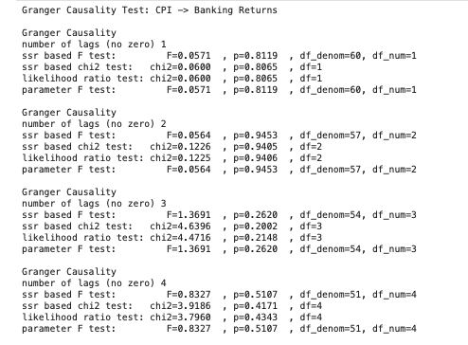
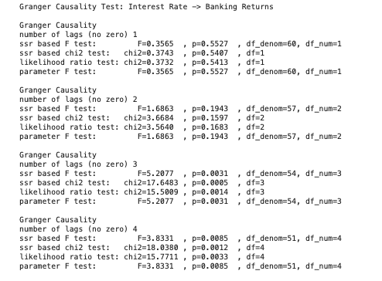
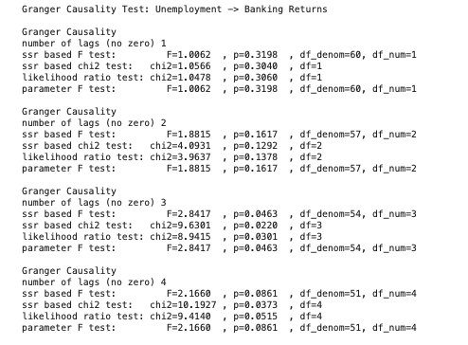
Granger causality tests
Notes:
Summary of Findings
CPI: Does not Granger-cause banking returns.
Unemployment: Provides marginal predictive power, with significance observed primarily at 3 lags.
Interest Rate: Demonstrates strong Granger causality, particularly at 3 and 4 lags.
Implications:
These results suggest that macroeconomic indicators like unemployment and interest rates can be critical predictors of banking sector performance when lagged appropriately. While CPI shows no significant impact, changes in unemployment and interest rates, particularly with a time delay, should be incorporated into forecasting models for better predictions of banking returns. This insight can guide financial analysts and policymakers in understanding how economic shifts influence the banking sector.

Slide 34
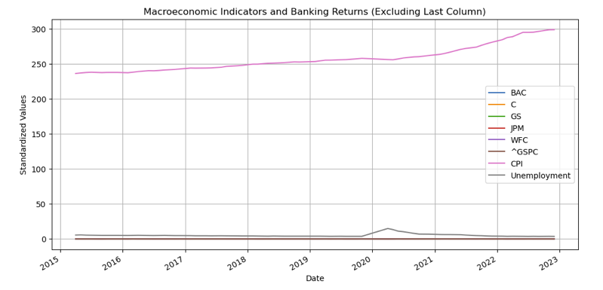
Combined trends analysis
Notes:
The Combined Trends Visualization overlays the standardized values of macroeconomic indicators (CPI and Unemployment) alongside the banking sector's returns for specific stocks (BAC, C, GS, JPM, WFC) and the market index (^GSPC). Here’s an analysis of the visualization:
Analysis of Trends
Banking Sector Returns (BAC, C, GS, JPM, WFC, and ^GSPC): The market index (^GSPC) exhibits consistent growth over the analyzed period, reflecting the overall market's positive trend. Individual banking stocks display relatively subdued variations compared to the index, with limited major deviations or trends.
Macroeconomic Indicators: CPI (Consumer Price Index) shows a steady upward trend over time, indicative of consistent inflationary pressure in the economy. Unemployment remains relatively stable for most of the period, except for a sharp spike around 2020, corresponding to the COVID-19 pandemic's economic disruption.
Impact of Macroeconomic Trends on Returns: The visualization demonstrates that CPI follows a predictable trend, but its fluctuations have minimal visible correlation with banking returns. Unemployment's sharp increase during 2020 aligns with disruptions in banking returns, particularly during the market's turbulence. This suggests a stronger potential relationship, aligning with Granger causality results.
-nsights and Implications: The steady rise in CPI does not seem to cause significant variations in banking returns, supporting the earlier analysis that CPI does not Granger-cause banking returns. Unemployment, with its notable spike in 2020, could have had a lagged effect on banking returns, aligning with the Granger causality findings at higher lag levels. The banking sector’s overall performance aligns closely with the broader market (^GSPC), indicating strong correlation and market dependence.

Slide 35
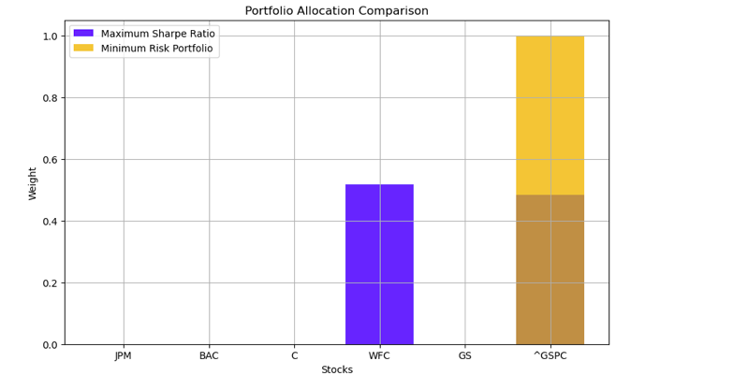
Portfolio allocation
Notes:
The Portfolio Allocation Comparison visualization presents the differences in stock allocation for two portfolios: one optimized for the maximum Sharpe ratio and the other for minimum risk. Here's a detailed analysis:
Maximum Sharpe Ratio Portfolio:
This portfolio seeks to maximize the risk-adjusted returns, balancing returns against volatility.
Allocation: Heavy weighting in WFC (Wells Fargo) (52). Significant allocation to the market index ^GSPC (48). No allocation to JPM, BAC, C, or GS.
The focus on WFC and ^GSPC suggests these assets offer the best trade-off between risk and return in the current market environment.
Minimum Risk Portfolio:
This portfolio prioritizes minimizing portfolio volatility.
Allocation: Majority weight is allocated to ^GSPC (~100%). Minimal to negligible weight allocated to other stocks, including JPM, BAC, C, WFC, and GS. This heavy reliance on ^GSPC reflects the stability and lower risk associated with the broader market index compared to individual banking stocks.
Comparison: The Maximum Sharpe Ratio Portfolio is more diversified, splitting investments between WFC and ^GSPC. This diversification leverages higher returns from WFC while maintaining stability through ^GSPC. The Minimum Risk Portfolio leans entirely on ^GSPC, reflecting its role as a low-risk, market-wide investment vehicle.
Implications for Investors: Investors seeking to maximize returns relative to risk should consider a portfolio emphasizing WFC and ^GSPC, as these two assets exhibit favorable Sharpe ratios. Risk-averse investors aiming to minimize volatility may prefer the stability of the market index, reflected in the Minimum Risk Portfolio's heavy allocation to ^GSPC.

Slide 36
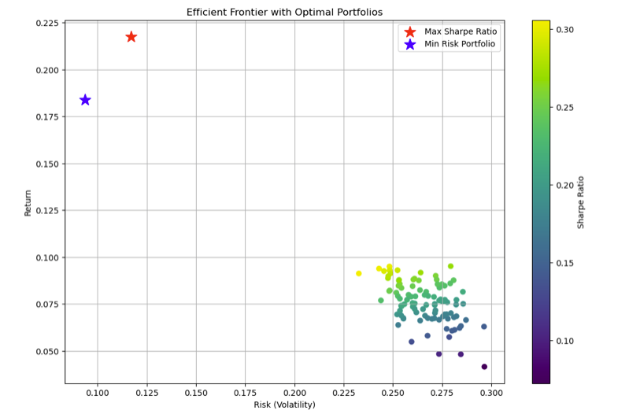
Efficient frontier with optimal portfolios
Notes:
The Efficient Frontier with Optimal Portfolios visualization provides a clear representation of the trade-off between risk (volatility) and return in portfolio construction. The curve, known as the efficient frontier, highlights the set of optimal portfolios that maximize expected returns for a given level of risk. Two key portfolios are identified: the Maximum Sharpe Ratio Portfolio, represented by a red star, which achieves the highest risk-adjusted returns by maximizing the Sharpe Ratio, and the Minimum Risk Portfolio, shown with a blue star, which minimizes volatility. The Maximum Sharpe Ratio Portfolio is positioned at the top of the frontier, balancing returns and risk, while the Minimum Risk Portfolio sits at the leftmost point, offering stability over returns.
The color gradient in the visualization further emphasizes portfolio efficiency, with brighter yellow-green tones indicating higher Sharpe Ratios and darker tones representing lower values. Investors can use this information to align their objectives with portfolio selection, whether by maximizing returns relative to risk or minimizing volatility. This visualization underscores the importance of diversification and enables investors to make informed decisions based on their risk tolerance and investment goals, with the efficient frontier serving as a guide to optimal portfolio allocation.

Slide 37
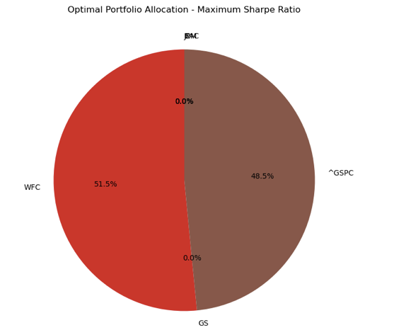
Optimal portfolio allocation (maximum sharpe ratio)
Notes:
The visualizations depict the optimal portfolio allocations under two different strategies: maximizing the Sharpe Ratio and minimizing risk. In the Maximum Sharpe Ratio Portfolio, weights are distributed primarily between Wells Fargo (WFC) with 51.5% and the S&P 500 Index (^GSPC) with 48.5%, while other stocks receive no allocation. This allocation suggests a preference for balancing returns and volatility by concentrating on these two assets, optimizing for the best trade-off between risk and return.

Slide 38
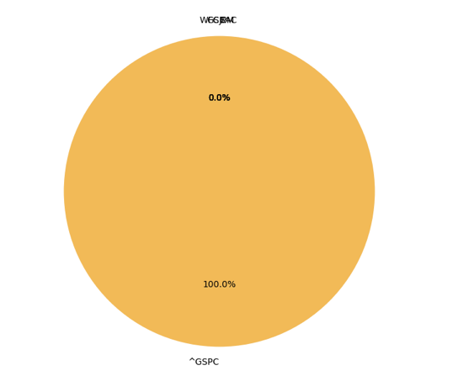
Optimal portfolio allocation (minimum risk)
Notes:
Conversely, the Minimum Risk Portfolio allocates 100% of the weight to the S&P 500 Index (^GSPC), highlighting its role as the least volatile and most stable asset in the set. This conservative approach ensures minimal portfolio variance but sacrifices diversification. These strategies emphasize contrasting goals in portfolio optimization: one aimed at maximizing return for a given risk level, and the other focused on reducing overall portfolio risk. Both visualizations provide a clear illustration of asset prioritization under these distinct objectives.

